Slide 1
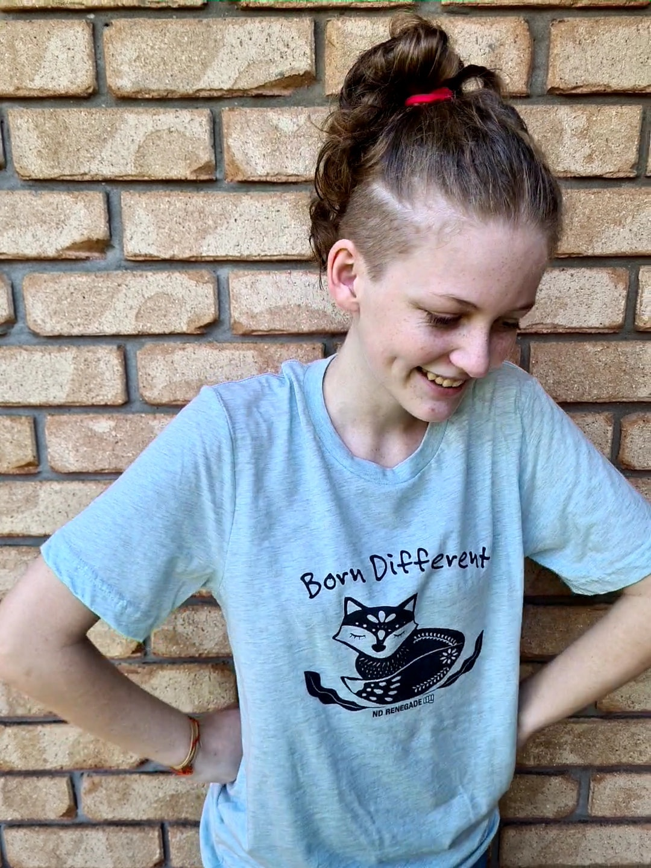
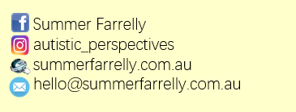
Hello, my name is Summer nice to meet you.
I use the pronouns them / they

Slide 2
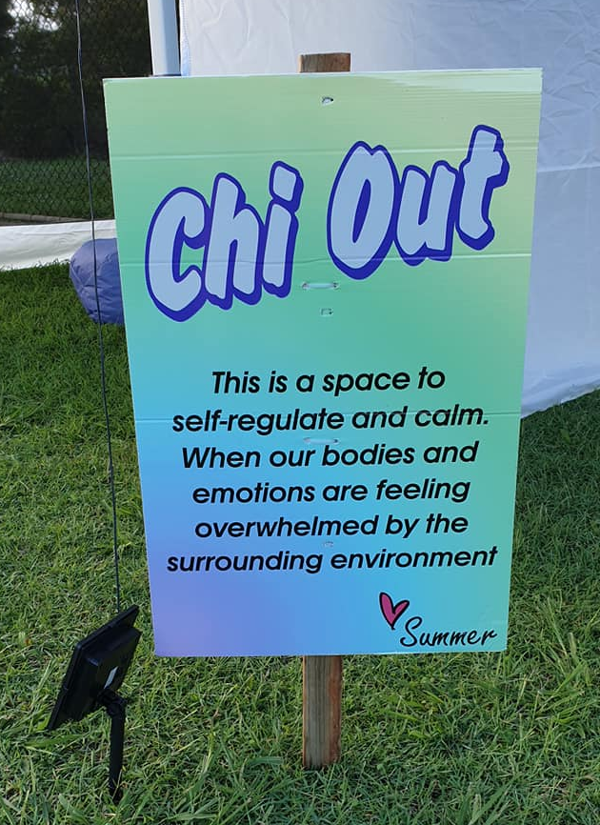
Chi Out

Slide 3
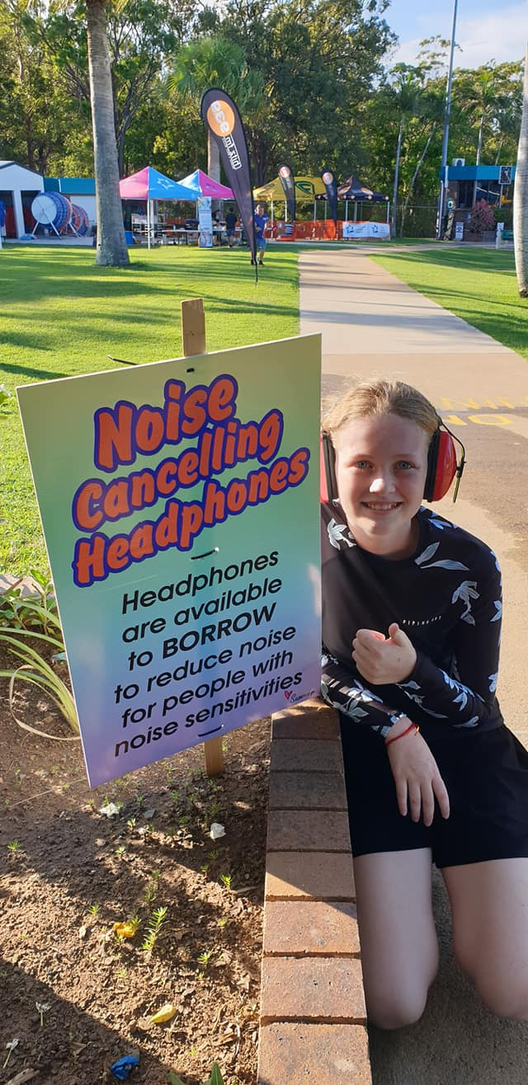
Noise Cancelling Headphones

Slide 4
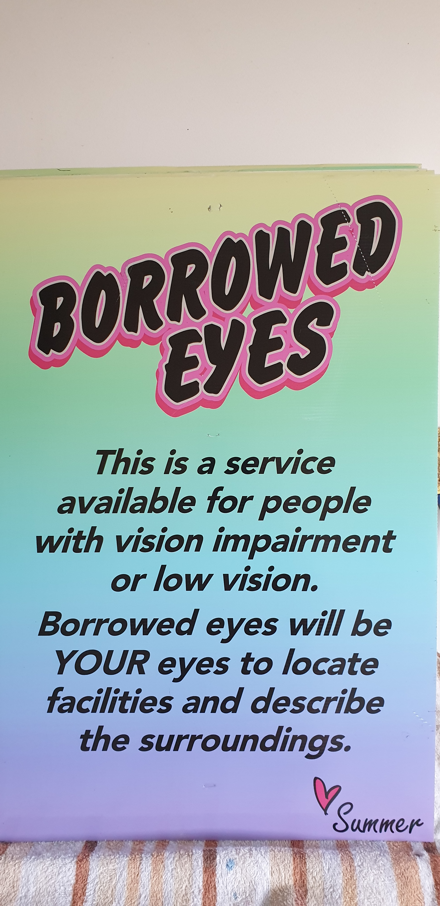
Borrowed Eyes

Slide 5
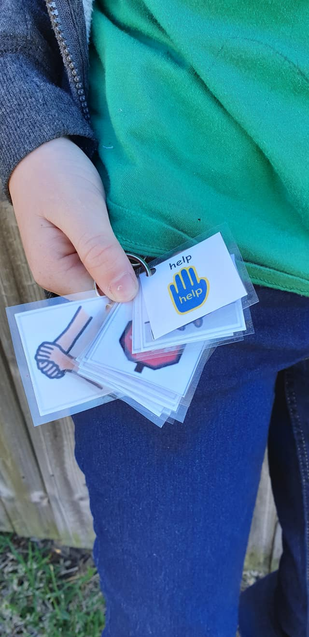
Basic Communication Visual Cards

Slide 6
Disability Rest Area

Slide 7
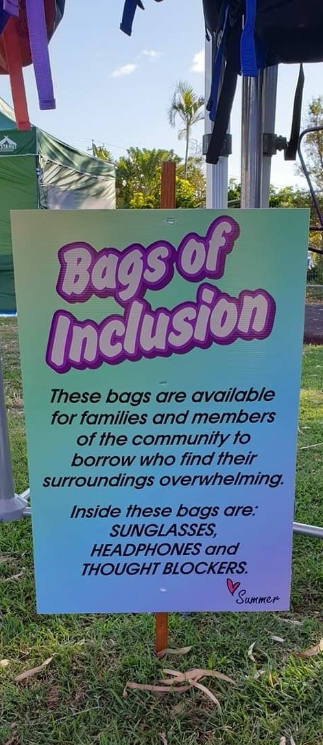
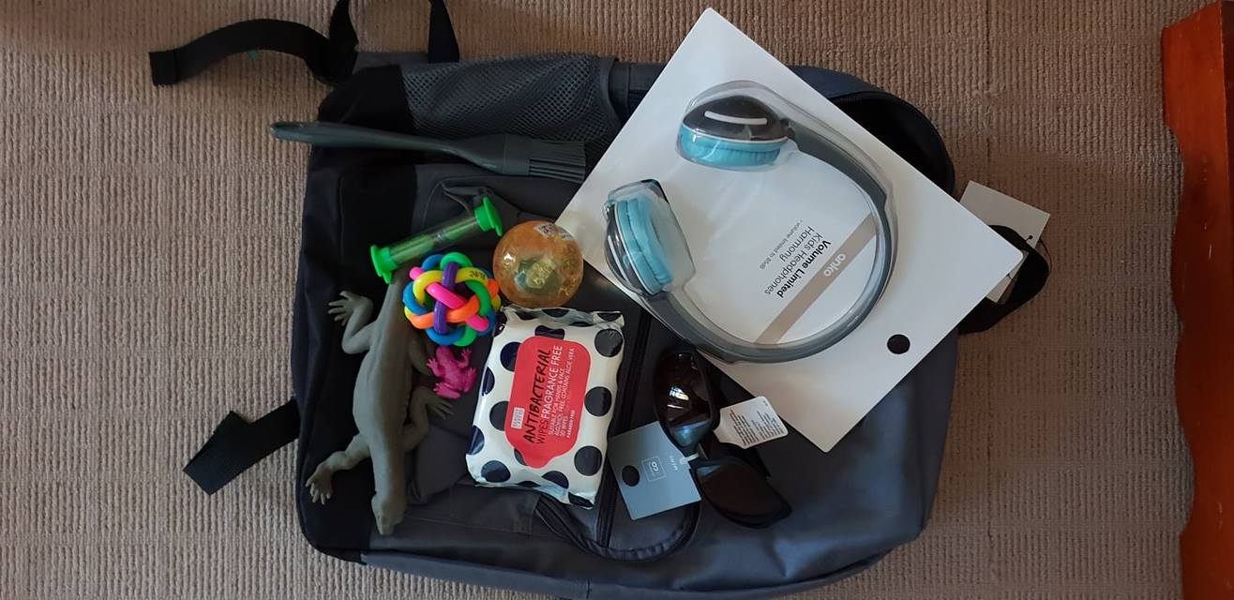
Bags of Inclusion

Slide 8
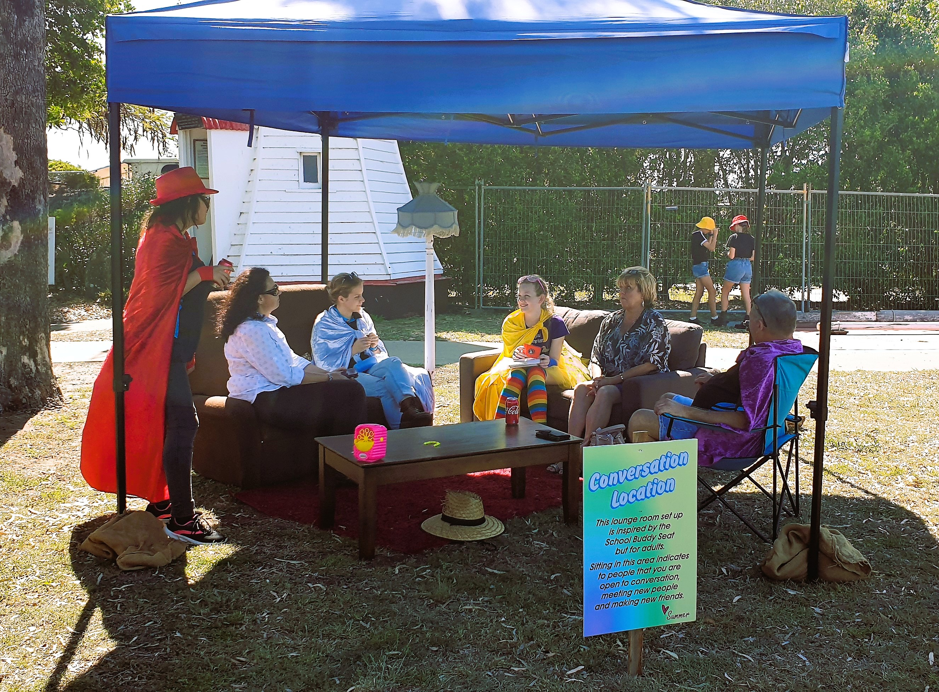
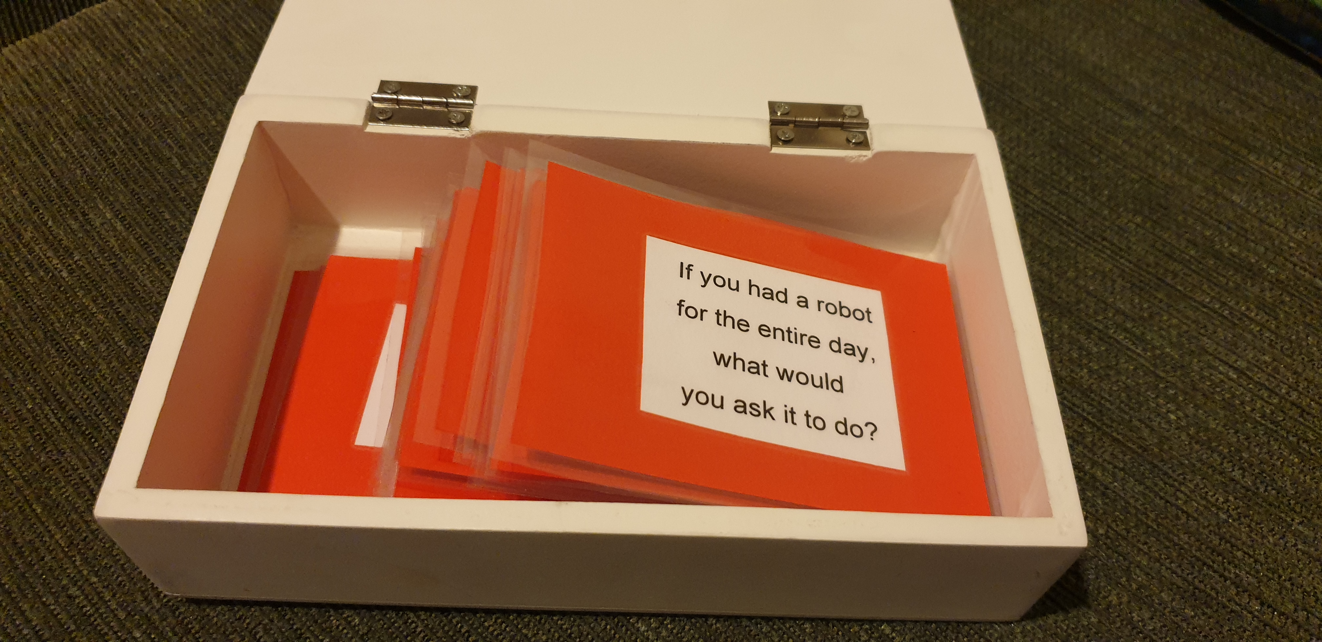
Conversation Location

Slide 9
Assistance Dog Rest Room

Slide 10
Thank you for having me

