Slide 1
Inclusion and Access in Outdoors
The Staffing Advantage – Grow your business’ success through inclusive employment and diversity
Thursday 24th March 2022
Delivered by Mathew Townsend
Founder and CEO, Nature Freedom

Slide 2
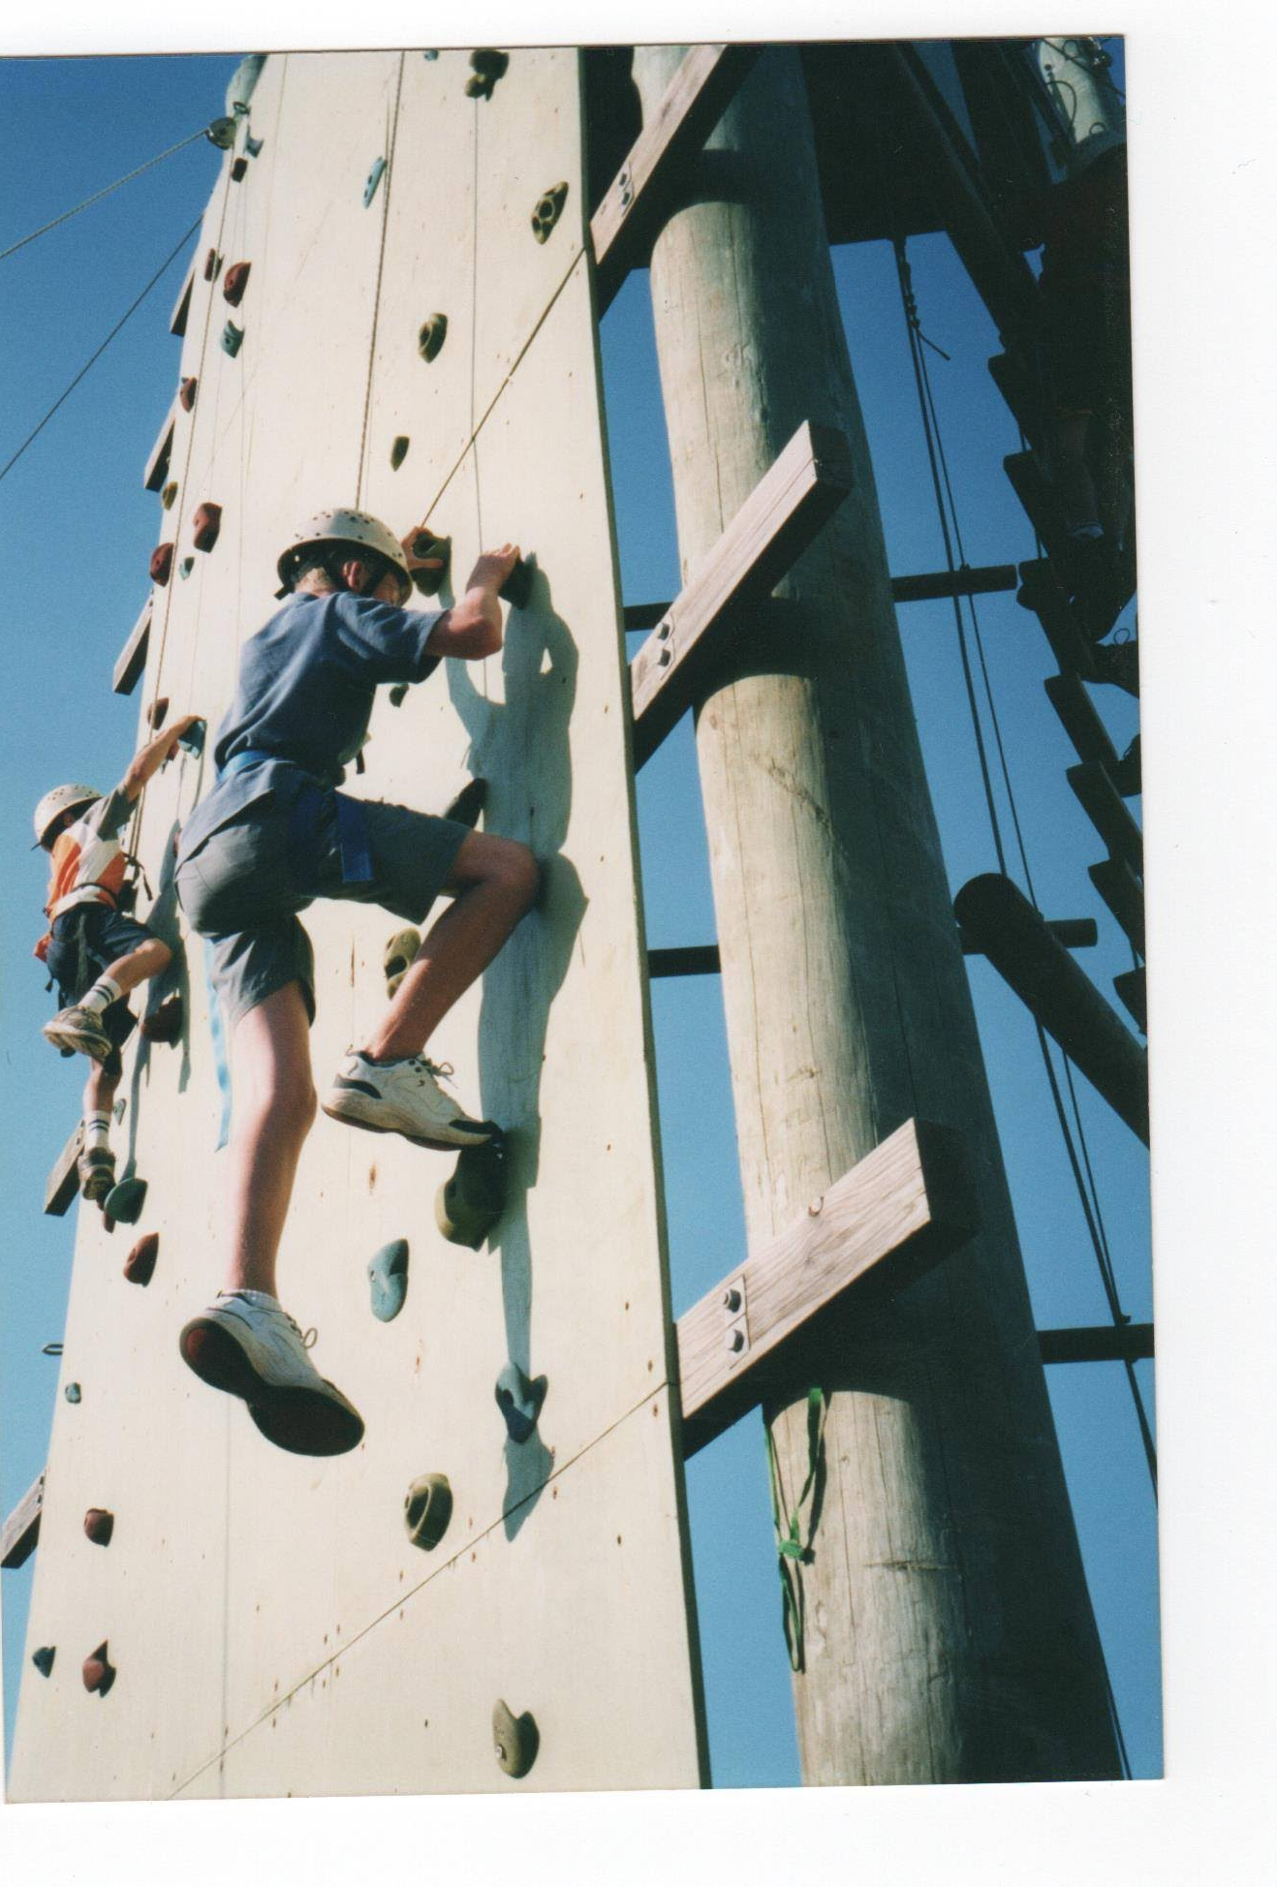
A journey from the past
Born without a disability. Diagnosed with profound to severe hearing loss at 18 months old, and mild case of Asperger’s at 12 years old.
Attended integrated primary school, and mainstream high school
Participated in recreational camps for deaf students

Slide 3
Challenges and barriers
Wear hearing aids in both ears – does not mean I can hear well
Asperger’s is now classified as high-functioning Autism
Faced prejudice and discrimination
Communication and social challenges
Was a statistic of 83% of Autistic people in Australia are in poverty and prolonged unemployment
Making friends and finding a girlfriend was hardest challenge I faced

Slide 4
Discovering the journey
After years of being socially isolated and rejected from career aspirations in outdoor and environmental space I decided to start my own business
Founded in May 2017 – 5 years milestone in May 2022.
Aim to build a community of like-minded individuals to share passions in nature and outdoor activities
Making friends, building connections and innovative employment opportunities are key focus
Vision – to create meaningful environmental impact and employment opportunities.

Slide 5
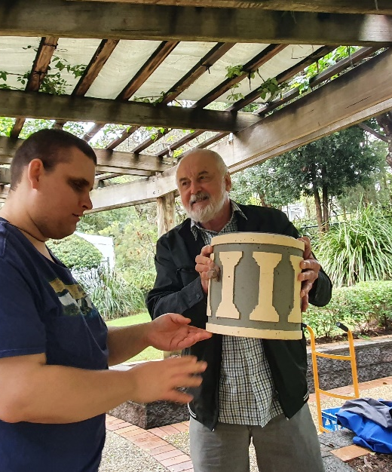
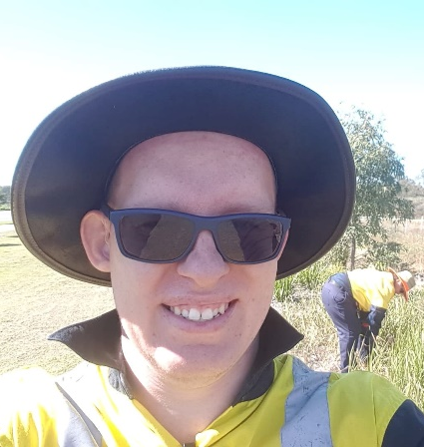
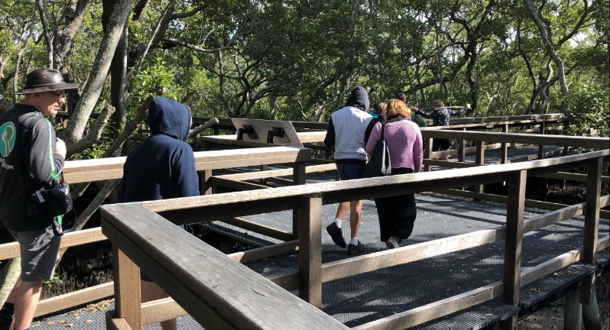
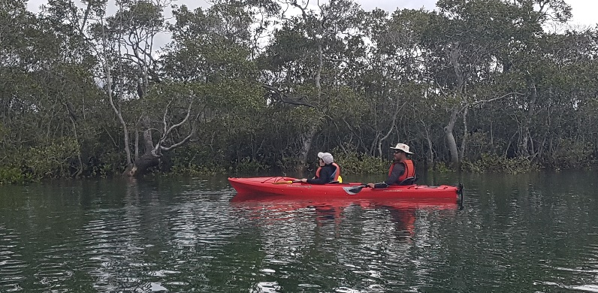
What services we offer?
Focus on social inclusion and employment ambitions. Programs are either free and low-cost/affordable.
Deliver as both community service and environmental services.
Our programs and projects are:
Inclusive paddling (kayaking and canoeing)
Inclusive Bushwalking
Inclusive Adventure trips (multiday inc)
Environmental crafts and nature workshops
Volunteer programs
Community partnership social programs

Slide 6
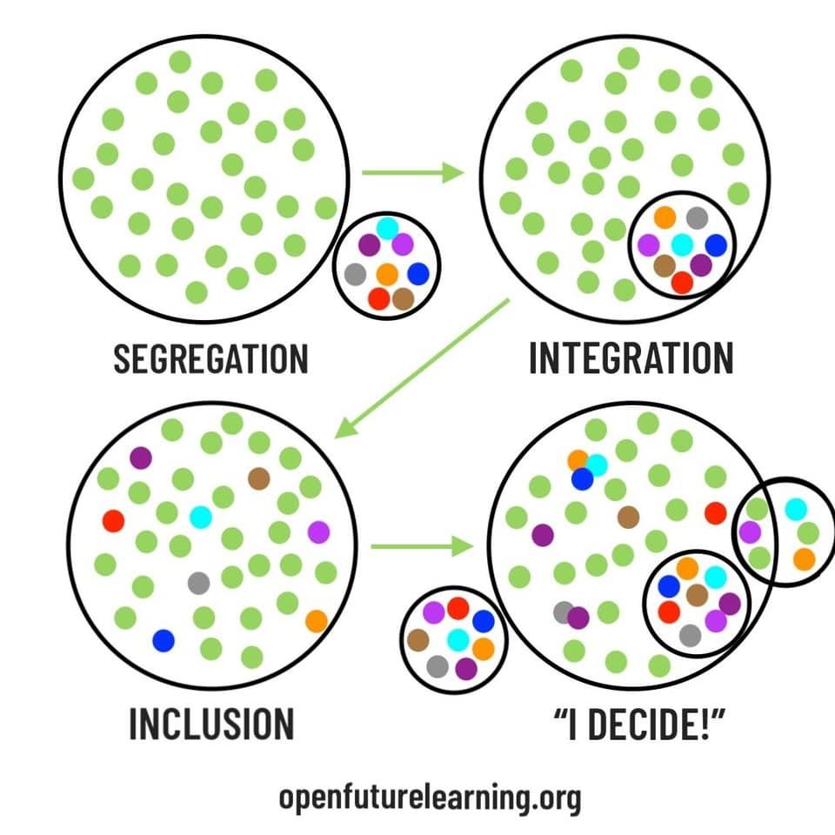
Define - Inclusion
Inclusion is poorly understood in many government and corporate sectors
Basically inclusion means “the action or state of including or of being included within a group or structure”

Slide 7
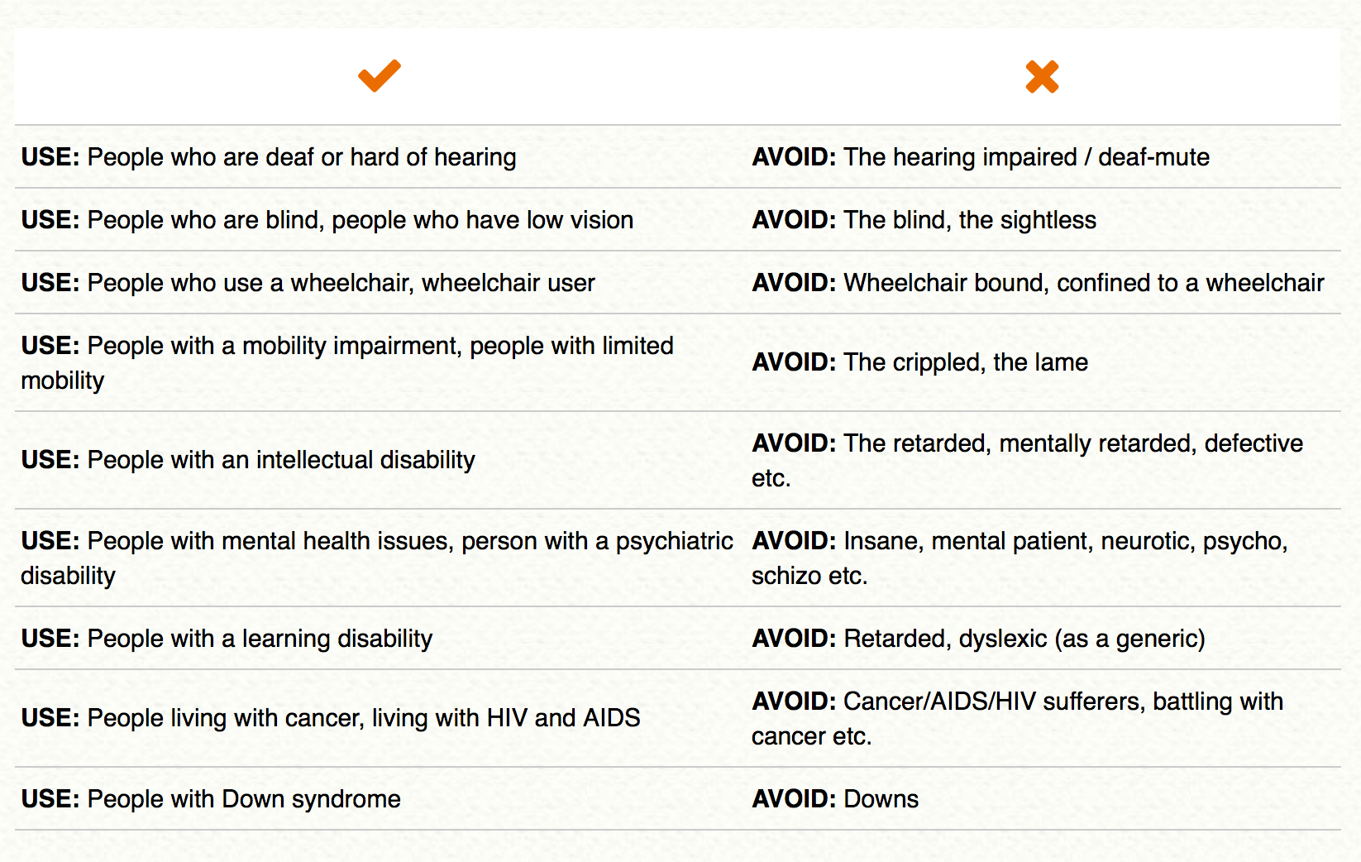
Strategies to make the program inclusive
Here is a checklist of approaches to make the program inclusion (be cautious this should not be treated as tokenistic!):
Ask for individual needs and support
Ask what their preferences in communications (e.g. emails instead of phone calls because of hearing loss)
Check if they are comfortable with the environment
Obtain and maintain physical infrastructure
Control and monitor the social environment

Slide 8
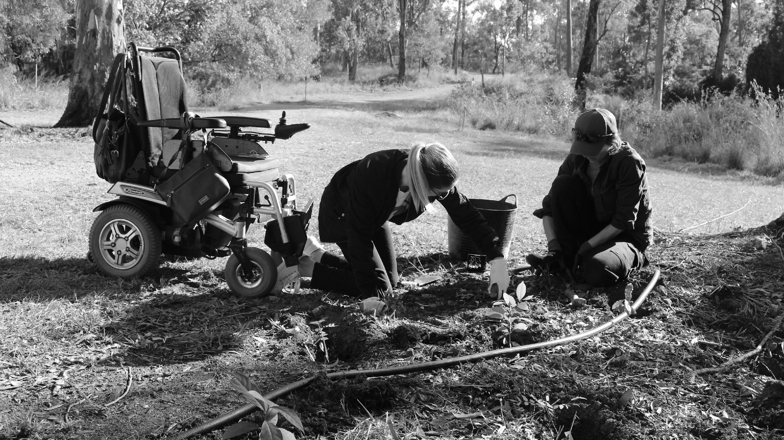
Solutions
Look out for value alignment
Integrate language and social model in your business model
Don’t focus too much on accessibility challenges
Co-design programs, projects and events with ‘other’ individuals

Slide 9
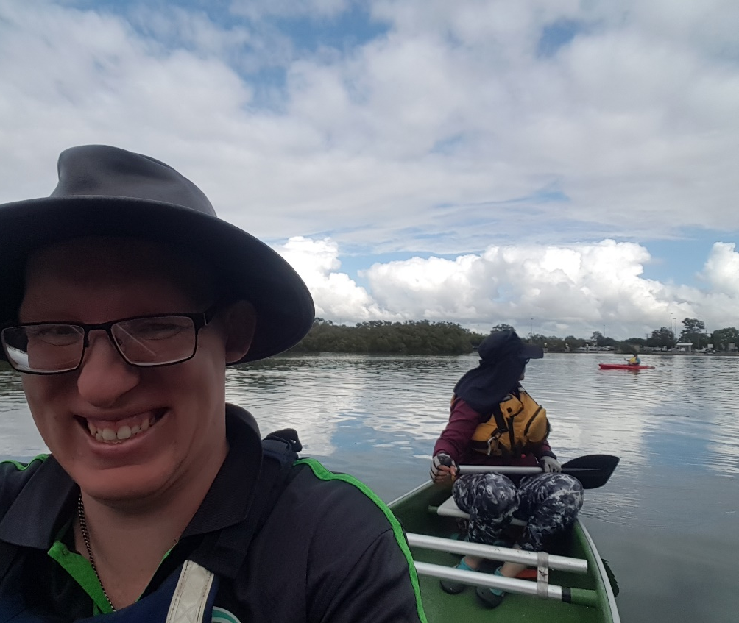
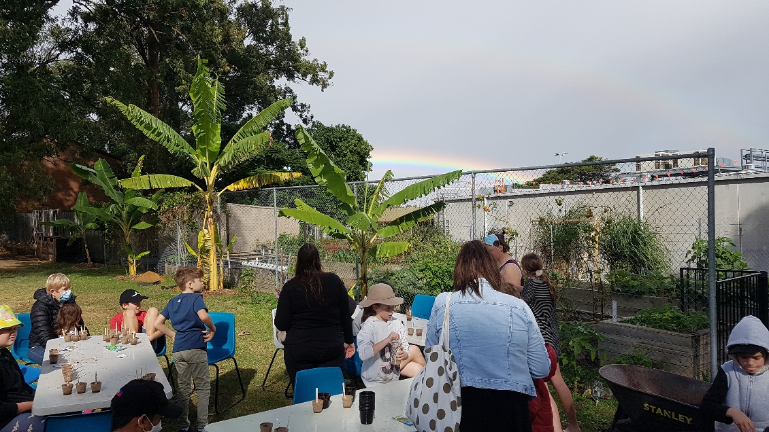
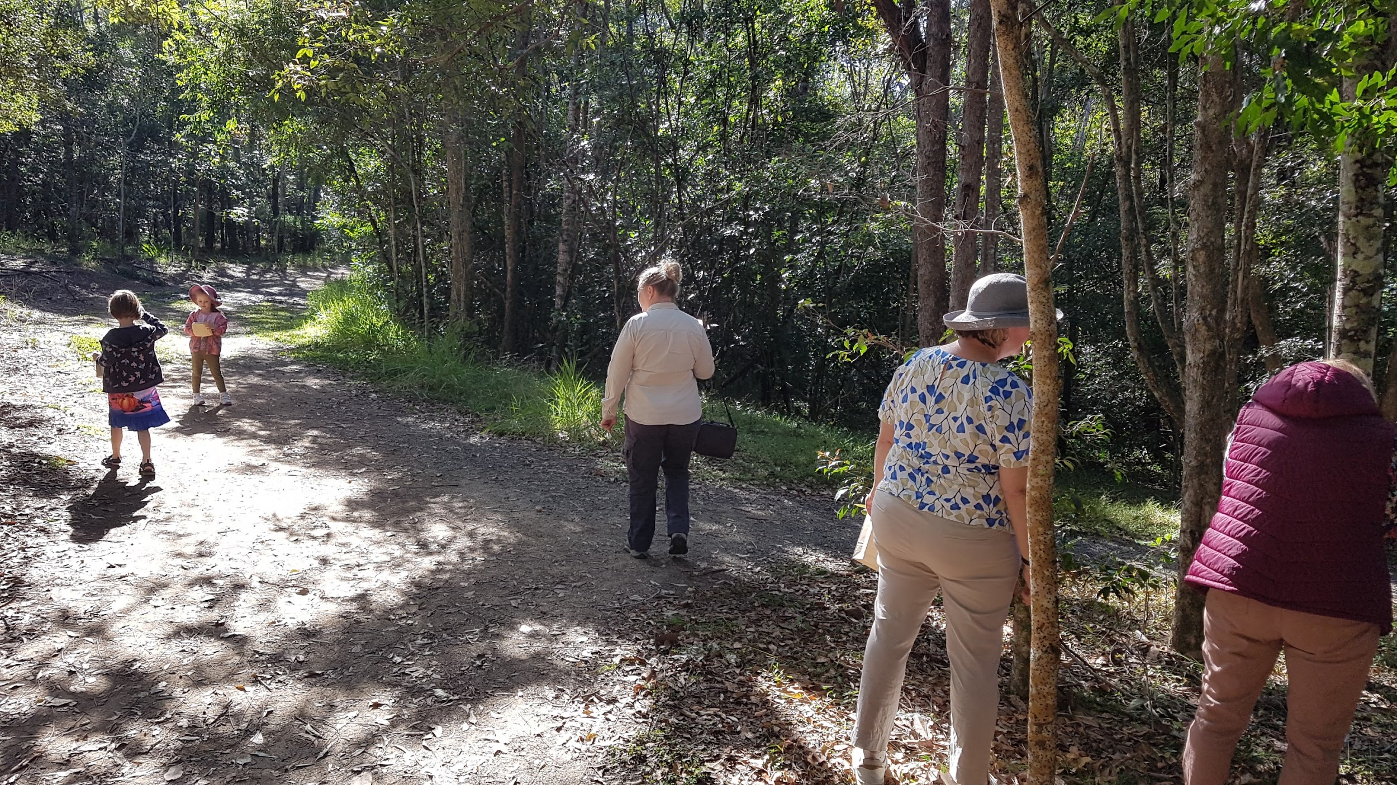
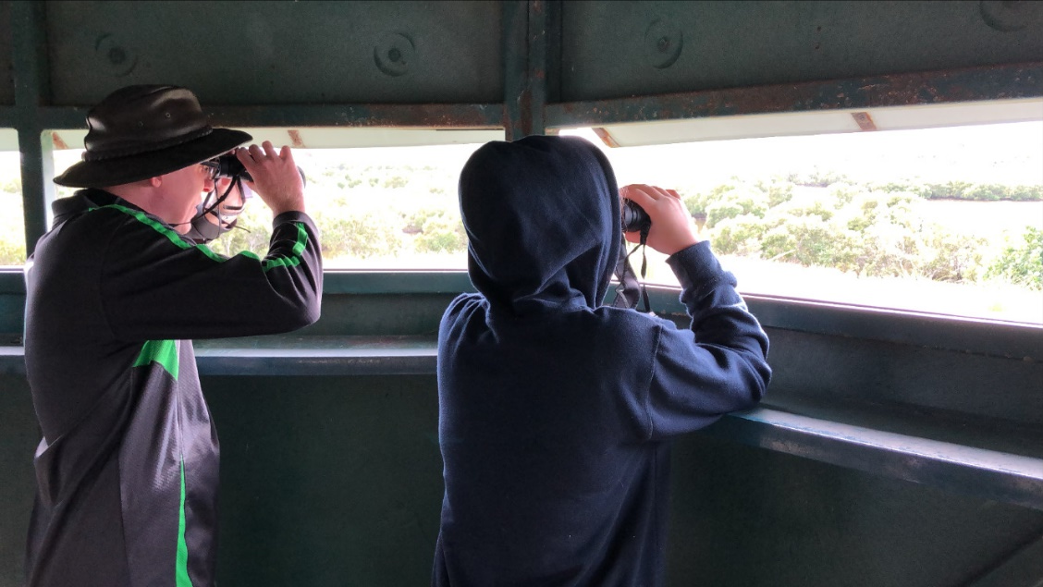
Recruiting strategy
In late 2021 we adopted open employment/volunteer program for PwD to be part of inclusive nature experiences.
Tips for this strategy
Focus on their time and space
Reciprocate their personal boundaries
Invest their time to build skills
Don’t look for someone is fully experienced
Go for the values and passions

Slide 10
Thank you
Mathew Townsend
Founder and CEO
Nature Freedom
W: www.naturefreedom.org.au
E: mathew@naturefreedom.org.au
F: www.facebook.com/naturefreedom/
L: www.linkedin.com/company/nature-freedom/
PO Box 4066 Gumdale QLD 4154

